Slide 1
Introduction to Transformer

Slide 2
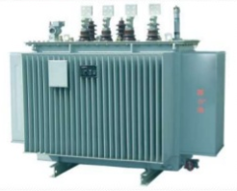
Introduction
Transformer is a static device.
It transfer electrical energy from one part of the electrical or electronic circuit to other part of circuit without changing the frequency.
It works on the Michal Faradays law of Electromagnetic Mutual Induction

Slide 3
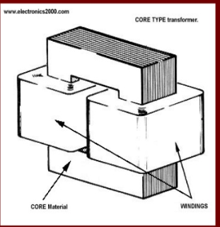
Types of Transformer
Core Type Transformer
In the Core type the primary and secondary windings are placed on each side of the core.

Slide 4
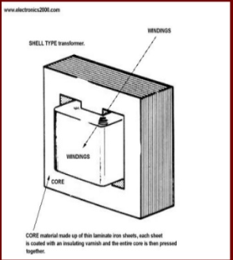
Types of Transformer
In Shell type transformers the LV & HV windings are sandwiched between each other.
shell type has three limbs.

Slide 5
Basis for Comparison | Core Type Transformer | Shell Type Transformer
Definition | The winding surround the core. | The core surround the winding.
Lamination Shape | The lamination is cut in the form of the L strips. | Lamination are cut in the form of the long strips of E and L.
Cross Section | Cross-section may be square, cruciform and three stepped | The cross section is rectangular in shape.
Copper Require | More | Less
Other Name | Concentric Winding or Cylindrical Winding. | Sandwich or Disc Winding
Limb | Two | Three
Insulation | More | Less
Flux | The flux is equally distributed on the side limbs of the core. | Central limb carry the whole flux and side limbs carries the half of the flux.
Winding | The primary and secondary winding are placed on the side limbs. | Primary and secondary windings are placed on the central limb
Magnetic Circuit | Two | One
Losses | More | Less
Maintenance | Easy | Difficult
Mechanical Strength | Low | High
Output | Less | High
Natural Cooling | Does not Exist | Exist

Slide 6
Types of Transformer
Step Up Transformer
A transformer in which voltage across secondary is greater than primary voltage is called a step-up transformer.
In this type of transformer, Number of turns in secondary coil is greater than that in Primary coil, so this creates greater voltage across secondary coil to get more output voltage than given through primary coil.
STEP DOWN TRANSFORMER
A transformer in which voltage across secondary is lesser than primary voltage is called a step-down transformer.
•In this type of transformer, Number of turns in secondary coil is lesser than that in Primary coil, so this creates lesser voltage across secondary coil, so we get low output voltage than given through primary coil.

Slide 7
Various Transformer
A wide variety of transformer designs are used for different applications.
Auto-transformer.
Poly-phase transformer.
Leakage transformer.
Resonant transformer.
Instrument transformers

Slide 8
Characteristics of Ideal Transformer
No winding resistance.
No leakage flux i.e., the same flux links both the windings
no iron losses (i.e., eddy current and hysteresis losses) in the core

Slide 9
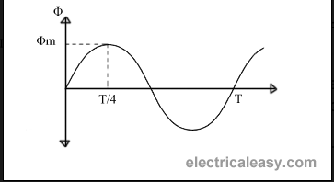
EMF Equation of Transformer
Let, N₁ = Number of turns in primary winding N₂ = Number of turns in secondary winding Φ_{m} = Maximum flux in the core (in Wb) = (B_{m} x A) f = frequency of the AC supply (in Hz)
average rate of change of flux = Φm /(T/4) = Φm /(1/4f)
Therefore, average rate of change of flux = 4f Φm
Now,
Induced emf per turn = rate of change of flux per turn
Therefore, average emf per turn = 4f Φm

Slide 10

Continue…..
Form factor = RMS value / average value
RMS value of emf per turn = 1.11 x 4f Φm = 4.44f Φm.
Voltage Transformation Ratio (K)
Where, K = constant This constant K is known as voltage transformation ratio. If N₂ > N₁, i.e. K > 1, then the transformer is called step-up transformer.
If N₂ < N₁, i.e. K < 1, then the transformer is called step-down transformer.

Slide 11
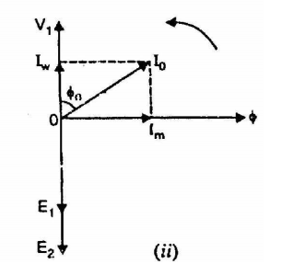
Transformer on No-Load
Why copper loss is low at no-load conditions?
At the no-load condition, a very little amount of current flow through the transformer. This current is known as energized current.
This current has two components (i) magnetizing current (ii) iron loss component
At no-load condition, copper loss is low which can be negligible.

Slide 12
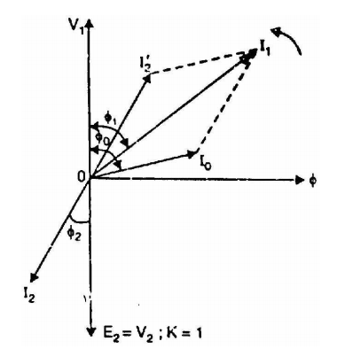
Transformer on Load
With increasing load on secondary, the current in primary will increase.
Under loaded condition, The primary current is the vector sum of I’2 and I1.

Slide 13
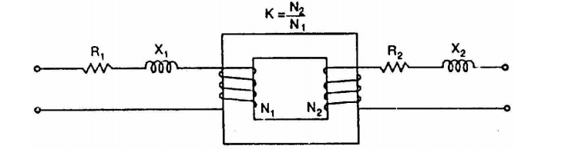
Equivalent Circuit Diagram

Slide 14
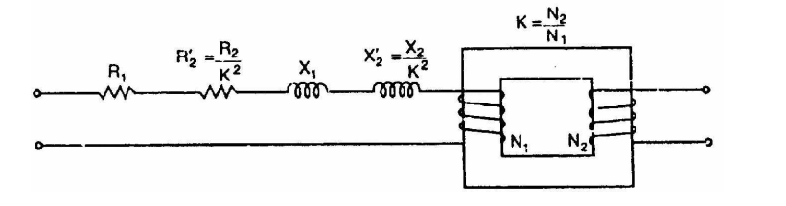
Continue….
Referred to Primary:

Slide 15
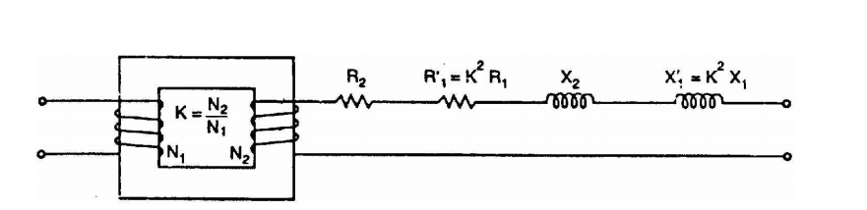
Continue….
Referred to Secondary:

Slide 16
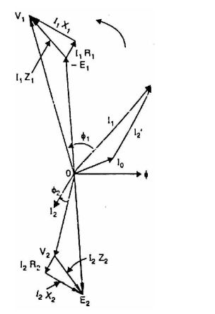
Full Load Phasor Diagram

Slide 17
Losses of Transformer
Two types of losses can be found in transformer.
Core loss and Copper Loss
Core loss depends on voltage.
Copper loss depends on current.
Why Transformer rating in KVA?

